Slide 1
Protocols, Ports, APIs
Baylor Infosec

Slide 2
Protocols
Rules for documentation of communication
TCP – Transmission Control Protocol
HTTP\S – Hypertext Transfer Protocol\Secure
webpages
SMTP – Simple Mail Transfer Protocol
Email
And like a bajillion more

Slide 3
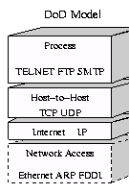
Protocol Layering
Abstraction of format, FTP doesn’t know about connection requirements from TCP or IP

Slide 4
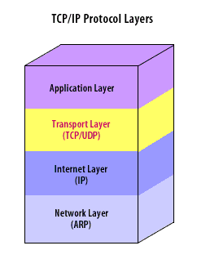
PORTS
A network port is a process-specific or an application-specific software construct serving as a communication endpoint, which is used by the Transport Layer protocols of Internet Protocol suite
In real people speak…

Slide 5
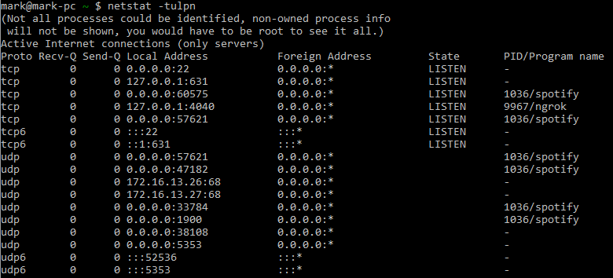
Ports
Server is just a process that monitors or sends info over a port/ip

Slide 6
Cool twitter example
Lets download a tweet using ports, APIS, and protocols

Slide 7
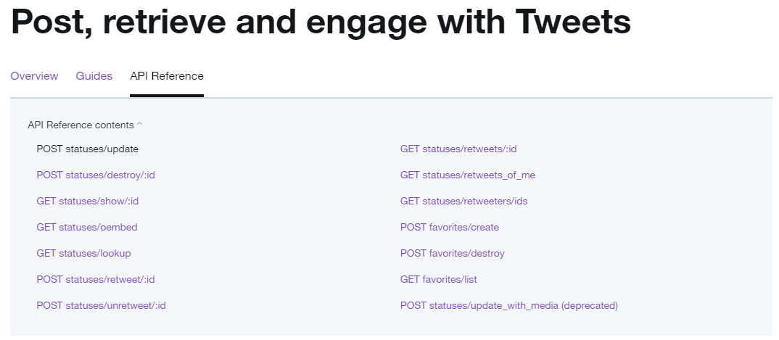

Slide 8
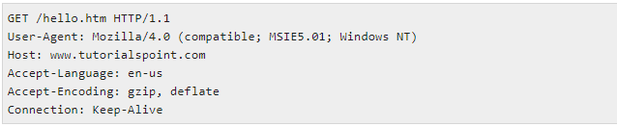

Slide 9
So using the API
Or just put this into a browser

Slide 10
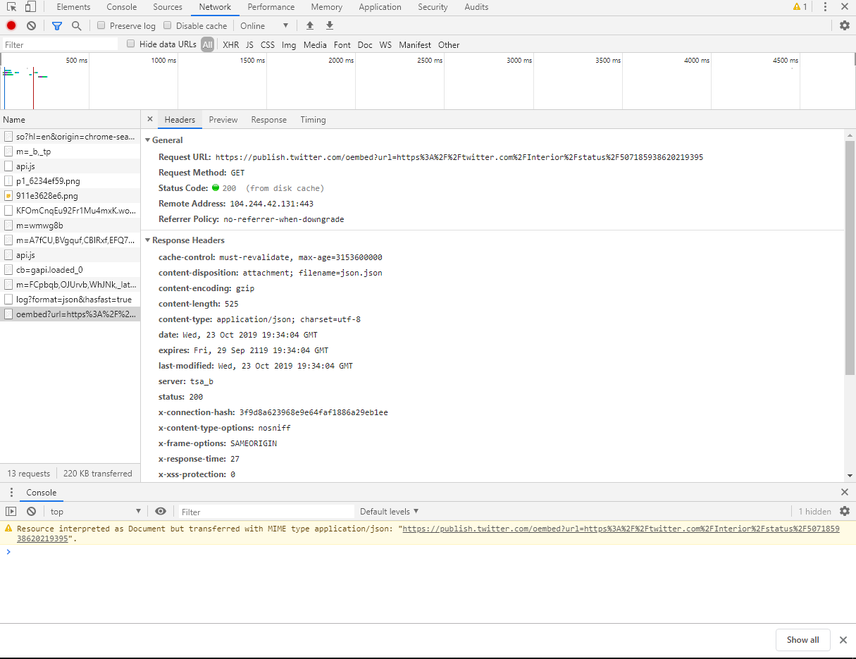
This Thing F-12

Slide 11
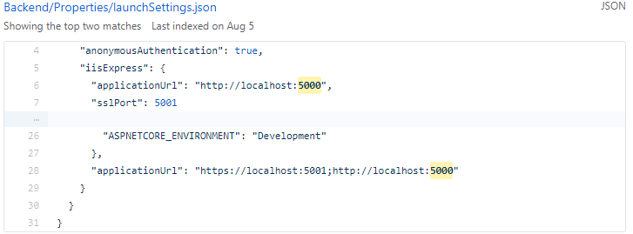

Slide 12
{ "url":"https:\/\/twitter.com\/Interior\/status\/507185938620219395", "author_name":"US Department of the Interior", "author_url":"https:\/\/twitter.com\/Interior", "html":"\u003Cblockquote class=\"twitter-tweet\"\u003E\u003Cp
lang=\"en\" dir=\"ltr\"\u003EHappy 50th anniversary to the Wilderness Act! Here&#39;s
a great wilderness photo from \u003Ca href=\"https:\/\/twitter.com\/
YosemiteNPS?ref_src=twsrc%5Etfw\"\u003E@YosemiteNPS\u003C\/a\u003E. \u003Ca
href=\"https:\/\/twitter.com\/hashtag\/Wilderness50?src=hash&amp;ref_src=twsrc%5Etfw
\"\u003E#Wilderness50\u003C\/a\u003E \u003Ca href=\"http:\/\/t.co\/HMhbyTg18X\“
\u003Epic.twitter.com\/HMhbyTg18X\u003C\/a\u003E\u003C\/p\u003E&mdash;
US Department of the Interior (@Interior) \u003Ca href=\"https:\/\/twitter.com\/Interior
\/status\/507185938620219395?ref_src=twsrc%5Etfw\"\u003ESeptember 3, 2014\u003C
\/a\u003E\u003C\/blockquote\u003E\n\u003Cscript async src=\"https:\/
\/platform.twitter.com\/widgets.js\" charset=\"utf-8\"\u003E\u003C\/script\u003E\n", "width":550, "height":null, "type":"rich", "cache_age":"3153600000", "provider_name":"Twitter", "provider_url":"https:\/\/twitter.com", "version":"1.0" }

